Slide 1

CONVENIENCE PACKAGING WITHOUT THE COST
Tallinn / San Francisco 2024

Slide 2

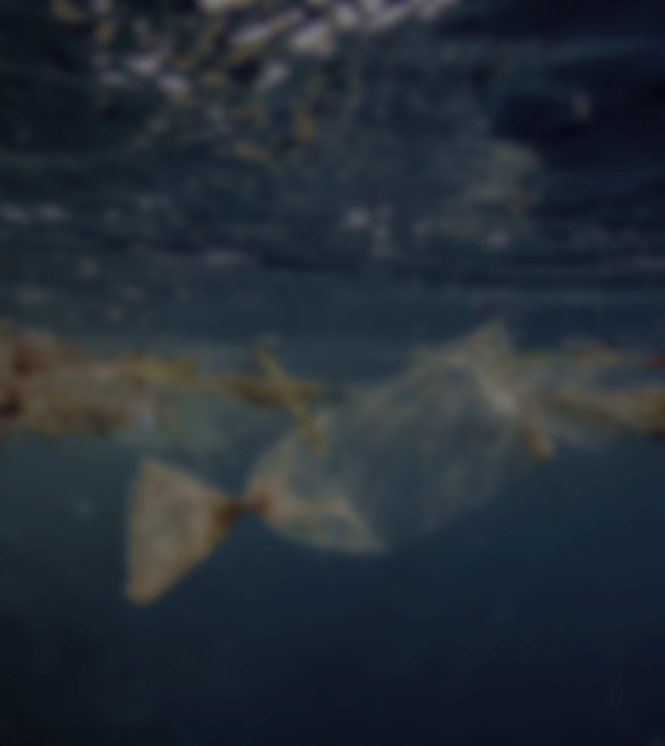
CONVENIENCE
PACKAGING
?
SUSTAINABILITY
HIGH QUALITY

Slide 3
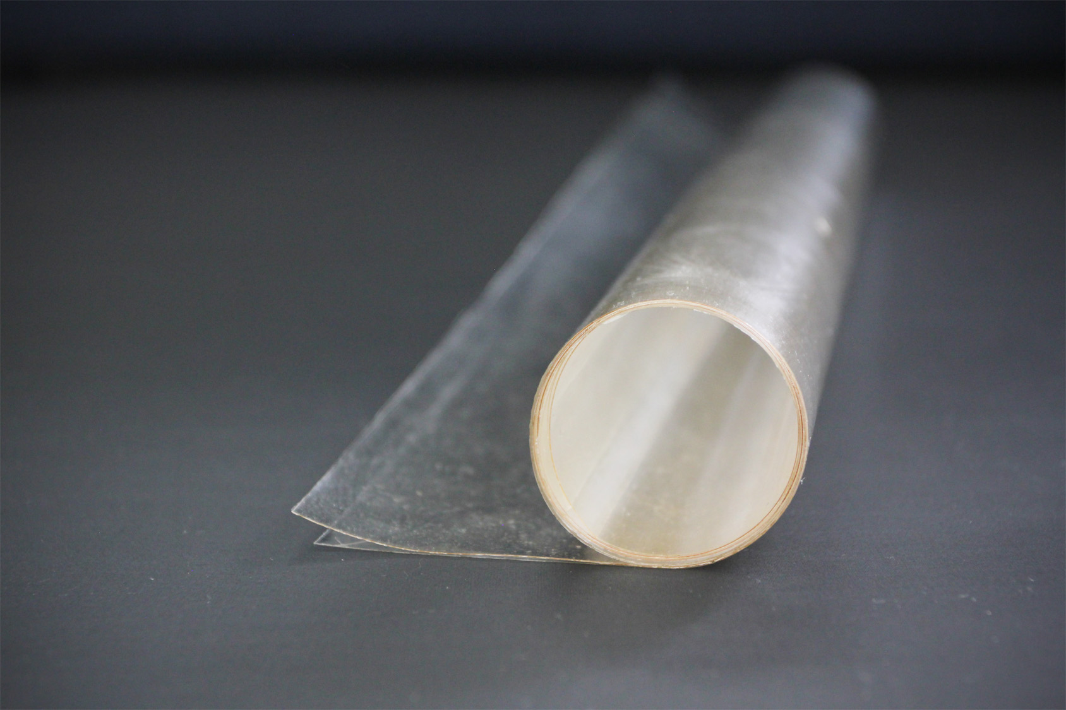

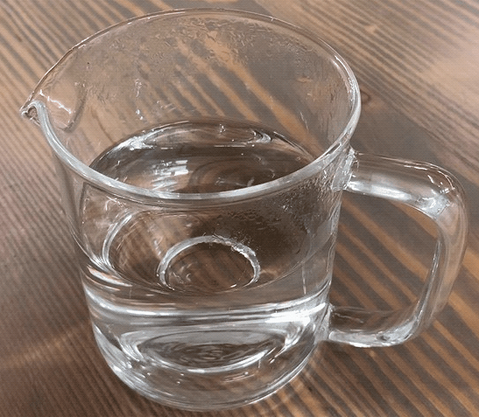
NOVEL FAST WATER-SOLUBLE AND EDIBLE PACKAGING MATERIALS

Slide 4
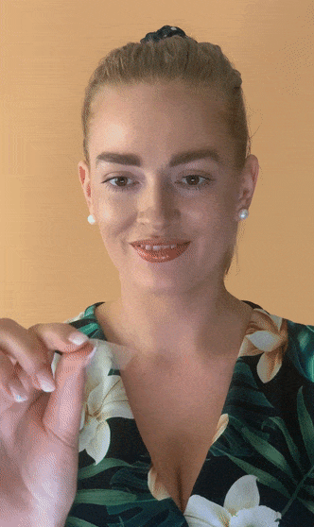

VIDEO OF EDIBLE FILM MATERIAL

Slide 5


DRAWBACKS OF EXISTING WATER-SOLUBLE MATERIALS
UNSUSTAINABLE
EXPENSIVE
MARKET SIZE: $5B (water-soluble packaging) ↑

Slide 6
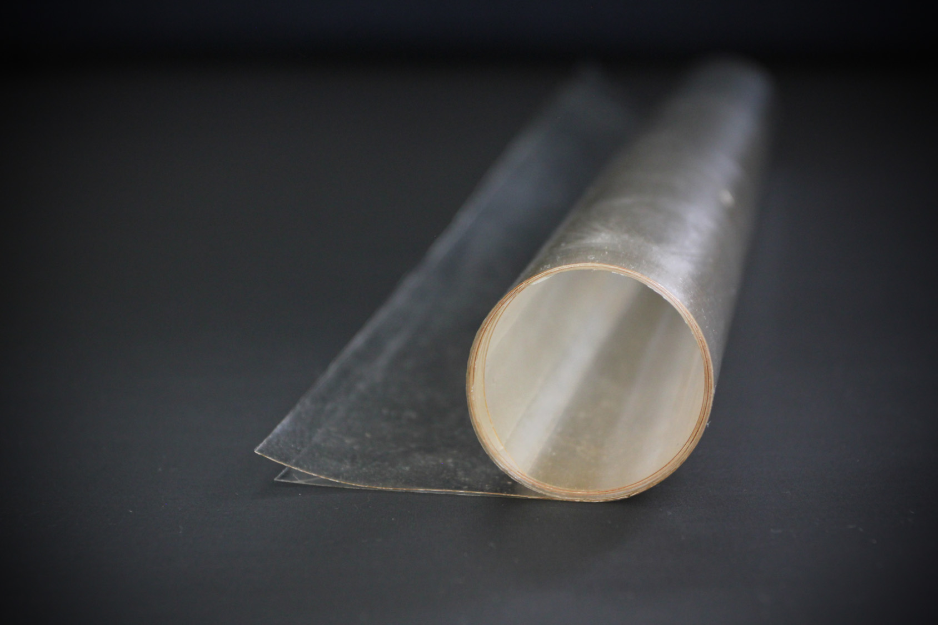






NOVEL FAST WATER-SOLUBLE
PACKAGING MATERIALS
PLANT-BASED
WATER-SOLUBLE
EDIBLE
HYPOALLERGENIC
TASTE(LESS)
ODOR(LESS)

Slide 7






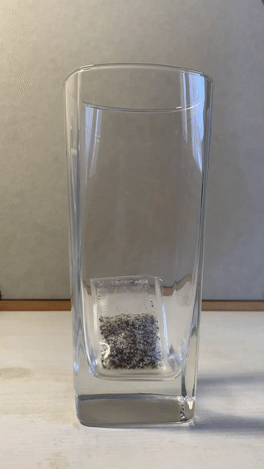
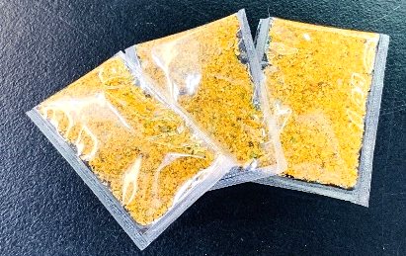
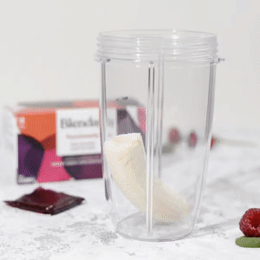
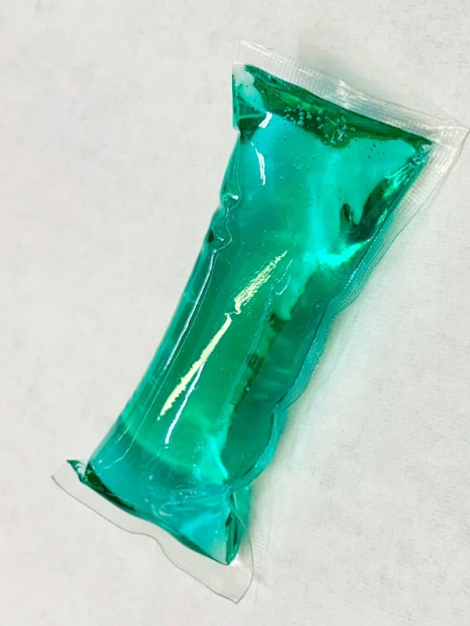
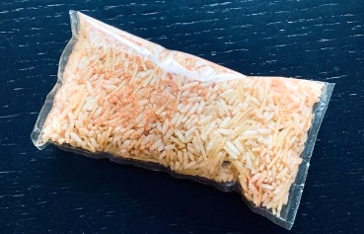
PILOTS WITH CUSTOMERS
WATER-SOLUBLE SEASONING AND FOOD PREPARATION PACKAGES
HOME & PERSONAL CARE PODS
BLENDABLE SUPERFOOD PACKS FOR SMOOTHIES

Slide 8

INTELLECTUAL PROPERTY
MATERIAL
FOOD PACKAGING | HOME & PERSONAL CARE PRODUCTS

Slide 9
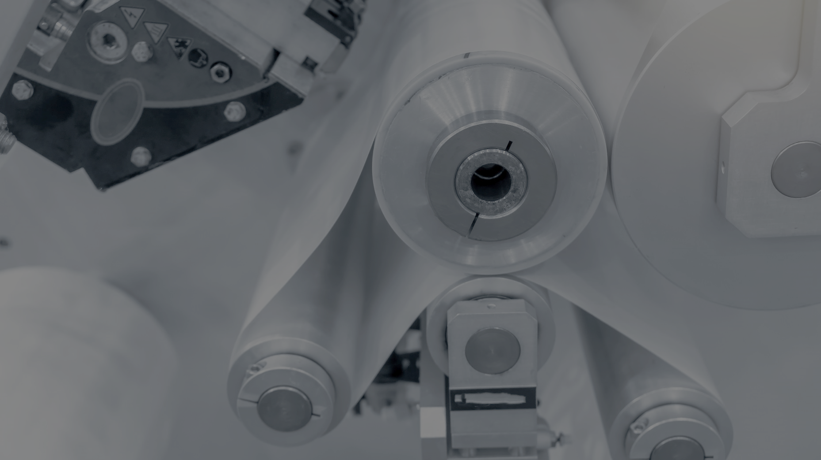




PRODUCTION
PROTOTYPES
FOOD GRADE PRODUCTION SITE
OPERATING IN ESTONIA
SCALABLE MASS PRODUCTION MACHINERY HAS BEEN TESTED

Slide 10
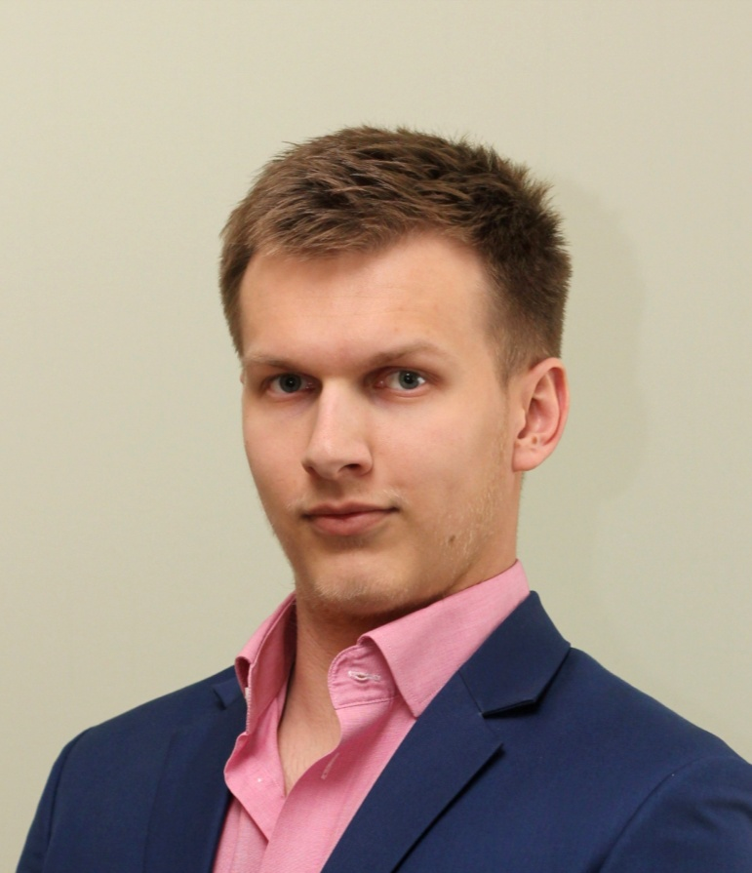


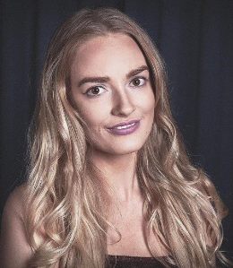





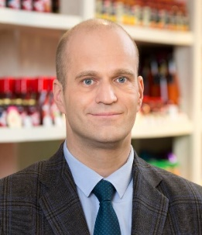


OUR COMPANY
Mart Salumäe
Co-Founder & CEO
MSc in Materials Science
Forbes 30 Under 30
Kelly Kangur
Co-Founder & CBO
MBA in Technology Management
Forbes 30 Under 30
Marek Viilol
Marketing & Sales Director
25yrs Food Industry Experience
Orkla
Previous Investments: $350k

Slide 11
FUNDING ROADMAP
SEED
Industrial Production
Production Optimisation
Pilots with Food Corporations
2 Industrial Scale Clients
Secured and Sales Started
RAISE:
$1M
($700k committed)
SAFE Valuation Cap $4M
(+ $2M grant)
SEED+
Scaling
2 Continuous Clients
Finishing 3 Pilots for
Next Products
Production Scaling
Raise: $4M
Valuation $15M
(in 18 months)
PRE-SEED
Validation
R&D + Prototypes
Patent Filing
Pilot Production
Facilities
Raise: $350k
SAFE Valuation Cap $3M

Slide 12
Mart Salumäe - CEO
www.decomertechnology.com
mart@decomertechnology.com
+372 523 65 81 (Worldwide) | +1 (415) 799-7311 (US)
Tallinn, Estonia | San Francisco, USA

